Slide 1
Evaluation studies: From controlled to natural settings
14.1 Introduction
14.2 Usability testing
14.3 Conducting experiments
14.4 Field studies

Slide 2
The aims:
Explain how to do usability testing.
Outline the basics of experimental design.
Describe how to do field studies.

Slide 3
14.2
It is conducted in a controlled environments – product to be tested in a lab, where the performance of users on pre-planned tasks is repeatedly measured.
Goal – test whether the product is
usable by
the intended user population to achieve
the tasks for which it was designed.

Slide 4
14.2.1 methods, tasks, and users
Data:
  Video recording (users’ actions, facial expressions)
  Keystrokes & mouse movements (software logging)
  Think aloud
  Satisfaction questionnaire
    Purpose: How users actually feel about using the product
    Method: rate the system along a number of scales after interacting with the system.

Slide 5
  Interview (structured or semi-structured)
    What they liked / did not like
    How the product in used in the field

Slide 6
Tasks
  Searching for information
  Reading different typefaces
  Navigating different menus
  Performance measure
  Time: time users take to complete a task
  Number of error: error that users make
Number of users
  5-12
  Fewer users to get quick feedback (or under budget and schedule constraints)

Slide 7
Quantitative performance measure -- type of data
Time to complete a task.
Time to complete a task after a specified time away from the product. (間歇使用者)
Number and type of errors per task. (每項任務中錯誤率)
Number of error per unit of time. (一段時間內的錯誤率)
Number of navigations to online help or manuals.
Number of users making a particular error (犯同樣錯誤的人數)
Number of users completing a task successfully.

Slide 8
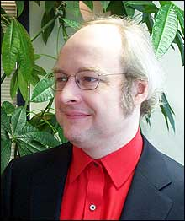
測試人數規模
早期進行測試在發現介面功能效力
  EX. Xerox測試在滑鼠上應有多少按鍵，進行了15次測試，共200使用者，花了400小時。即每次測試有10-15 USERS，每人2小時。最後發現應有3個按鍵。
通常可接受的數目是5-12個受測者，但當經費時間有限時可以更少。
As soon as the same kinds of problems start being revealed and there is nothing new – time to stop

Slide 9
14.2.2 Lab and equipment
Custom-built usability labs:
包括
  Main testing lab
  Observation room
  Reception area for testers
  Viewing room for observers
有時Lab可被稍微修改以模擬實際環境，如旅館的接待櫃台。當要測試CMC時 (如NetMeeting)，可將lab隔間以方便觀察。
Notes:
加上圖片

Slide 10
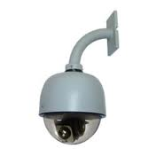
設備
  Wall-mounted video cameras (錄 hand movements, facial expression, body language)
  Microphones (think aloud 有聲思考)
mobile usability testing equipment-移動式測試設備 (Lab-in-a-box OR lab-in-a-suitcase)
  可攜帶至受測者的工作環境中進行測試
遠端測試 (remote usability testing)
  使用者在自己的工作或住家環境工進行測試，利用軟體的遠端記錄功能記錄下資料 (如Morae可以輸入IP來抓取資料)
Notes:
加上圖片

Slide 11
14.2.3 an example of usability testing: The iPad
Test of websites and apps specific to the iPad.
Two methods: usability testing and expert review.
key questions
  Are user expectations different for th eiPad compared with the iPhone?
  Whether it is worth developing specific websites for the iPad or would the desktop version be acceptable.
7 experienced iPhone users

Slide 12
Informed consent form
  What be asked to do
  Length of time
  Compensation
  Right to withdraw
  Identity not be disclosed
  Data be confidential
Comment
  What they were looking for /reading
  Like/dislike
  What made it easy or difficult to perform a task
Moderator sat next to each participant: observe and take note
90 minutes video recorded

Slide 13
Equipment
  Camera
  Webcam
  Laptop – Morae
  3 observers
Usability problems: Interaction with iPad was not optimal
  Interaction design principles
    Mental model
    Quality of images
    Touchscreen with small target areas
    Lake of affordance
    Get lost in the application
    Working memory
    Feedback
Interpreting and presenting the data

Slide 14
補充: Test procedure
在 lab 中受測者坐在電腦前
Explain the goal 告知測試目標及流程。
Explore the site for 10 mins 先花10分鐘熟悉網站
Work through five tasks, each 20 mins 開始進行5個任務，每個20分鐘，超過時間則停止。
Remind them to think out loud
Fill in post test questionnaire之後填寫後測滿意度問卷。
Finally in the debriefing (semi-structured conversation --informing people about their experience or allowing them to talk about it) session, participants were asked for their opinions.

Slide 15
補充: 界定出問題後要做的事
Using inspection problem reports for influencing design
Fixes and other redesign suggestions must be generated提出修正問題或重新設計的建議
Problems should be prioritized with respect to the severity of each problem 依問題嚴重性排列
  Severity ratings由對使用者或是產品市場的影響來判斷
3. Estimate of the software cost of implementing the suggested redesigns
Notes:
Ex.重要問題修正建議

Slide 16
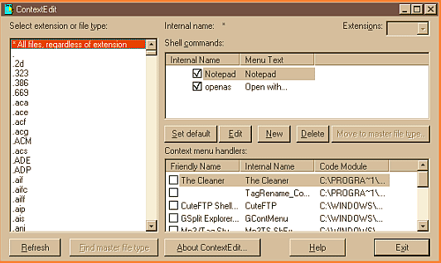
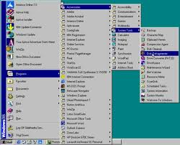
14.3
Conducting experiments
It is important to test a specific hypothesis that makes a prediction about the way users will perform with an interface.
  EX. of Hypothesis: context menus are easier to select options from compared with cascading 串聯式 menus.
Hypotheses are often based on a theory or previous research findings. Specific measurements are decided upon as a way of testing the hypothesis.
A hypothesis involves examining a relationship between two things, called variables (menu type and error rate).

Slide 17
IV: is what the investigator manipulates
DV: is a measure of the user performance and if our hypothesis is correct.
當設定假設來測試IV在DV的效果，通常要得到兩種假設when set up a hypothesis, it is usual to derive a null and alternative hypothesis
  Null hypothesis (虛無假設): there is no difference between Helvetica and Times font on reading time.
  The alterative hypothesis(對立假設): there was a difference between the two on reading time.

Slide 18
如何陳述假設： two-tailed or one-tailed
Two-tailed hypothesis (會有差異但不知哪個效果較好) -- 有兩種解讀 either Helvetica or Times is faster to read.
One-tailed hypothesis (已知哪個效果較好) --Helvetica is easier to read than Times.
如果我們有足夠的推論去支持某種設計比較好（從以前發現或是理論中），則提出 one-tailed hypothesis。否則則選 two-tailed hypothesis。

Slide 19
實驗設計 experimental design
實驗者要控制其他的變項固定不變 (constant），以免影響研究發現。通常有控制組以方便比較效果，例如。
  Control condition = Paper-based
  Condition 1 = Multimedia
  Condition 2= Virtual reality
Two IV: age & background，統計要看main effect and interaction
Notes:
P 662

Slide 20
Between /within subject:
哪些受測者安排在哪些 condition
Different-participant design（between-subject）:
A single group of participants is allocated randomly to each of the conditions 不同人參與不同condition.
好處是沒有ordering or training effects 因為每人僅進行一種condition，缺點是需要較多人
2. Same-participant design（within-subject）：
All participants perform in all conditions so only half the number of participants is needed.
主要原因是要降低個人差異的影響並檢視每個人在不同conditions的表現差異

Slide 21
Matched -participant design:
Participants are matched in pair based on user characteristics (gender..). Each pair is randomly allocated to each experimental condition
測量與data
  類似的DV (time, error rate)
  T test, mean, SD, p<0.05
  標準差使用作為統計分佈程度上的測量。 Standard deviation: measure of the spread or variability around the mean.

Slide 22
14.4 Field studies
Done in natural setting (technologies for use outside of office settings – mobile, ambient … )
Field studies are conducted to find out how a product is adopted and used by people in their working and everyday live.
Tasks are messy in the sense that activities often overlap and are constantly interrupted.
在Field studies中難以針對特定功能與介面項目進行使用性測試，反之，質化的資料及關於使用者行為及活動的描述顯現使用情況與反應。
Notes:
手術室影片 監控系統

Slide 23
時間：
  from a few minutes to a period of several months or even years.
Data collection:
  Observing and interviewing people (video, audio, field notes)<interview影片>
  受測者要填寫紙本或電子日誌（如使用手機時，記錄某個時段的情況）

Slide 24
Diary:
  when they are interrupted during their ongoing activity or when they encounter a problem when interacting with a product or when they are in a particular location (使用手機時進入隧道、網路遊戲攻城時被要求關機).
  資料包括frequency & patterning of certain activities (如飲食習慣，社會互動)

Slide 25
Use triggers to request them to anser questions 安裝在設備上的軟體在固定時間會提醒他們要填寫問題或是表格。例如記錄過去幾小時的聊天數量。
Let people know how long it takes 在記錄資料上需要讓使用者知道時間長短以及哪些會被記錄，例如安裝攝影機的地點（了解家庭成員如何使用new messaging system），並確保安全問題。

Slide 26
Privacy of participants
  Photographs (永安shadowing)
  What part is recorded and horopriated by people
How new technologies have been appropriate by people
  How the participants use, integrate, and adapt the technology to suit their needs, desires, and ways of living
  結果呈現寫成 vignettes, excerpts, critical incidents, patterns, and narratives to illustrate how the products are being adopted and integrated into their surroundings.

Slide 27
An in the wild study: the UbiFit garden
In the wild:
  evaluation takes place in a natural setting
  Researchers let free they technology to observe from afar how a new product is used by people in their own home… (從遠方觀察)

Slide 28
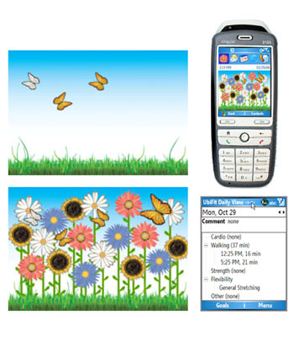
UbiFit -- Investigating how a ubiquitous, persuasive technology system can encourage individuals to incorporate regular and varied physical activity into their everyday lives
It consists of three main components:
  a glanceable display
  an interactive application
  a fitness device
Data collection & participants
  3 weeks, 12 participants, survey (75 respondents from 13 states)
Goals:
  identify usability problems
  How it fit into the everyday lives of the participants

Slide 29
Interviewed 3 times
  Attitude, set their activity goal …
Data
  Inferred by system
  Journaled (日誌)
  combination

Slide 30
Field studies– be conducted where a behavior only reveals itself after a long time of using a tool
  Efficacy: users are best studied in realistic setting
  Method:
    initial interview
    training session
    2-4 weeks of novice usage
    2-4 weeks of mature usage
    Semi-structured exit interview
  Other data: daily diaries, automated logs of usage, questionnaires, interview
  Use conceptual or theoretical framework (e.g. activity theory) to guide evaluation and data collection.

Slide 31
結論
Studies in the field
  How new product and prototypes will be used within context of use
  Interventions by evaluators are limited
Evaluations in lab
  Focus on usability and how users perform on tasks
With the development of wide variety of technologies, evaluators have to be creative in adapting the methods.

Slide 32
補充 Activity theory as an analytic framework
Use the theory to explain how artifacts mediate activity. Artifacts can be conceptualized in terms of how people learn and understand how to use new technologies
Four types:
  What artifacts: describe purpose of the design
  How artifacts: describe how the“what artifacts” are used
  Why artifacts: why a particular way of doing something is chosen 為何採用某種做事的方法
  Where to artifacts: a motive to change a behavior or understanding of how a product works. 指出改變行為或了解產品運作的動機為何

Slide 33
Collecting and analyzing data
透過蒐集的資料，調查者觀看多次記錄並做筆記，接著描述 describe a series of episodes that were particularly successful, problematic, surprising, or difficult to tackle.
Filed studies are useful when wanting to discover how products and prototypes will be used within their intended social and physical context of use. 在自然的情境中觀察使用習慣及其他活動，並描述產品是如何被使用。
Notes:
P 674

